Slide 1

Zensar Technologies Service Cloud Fixed Scope Offerings

Slide 2
Executive Summary
This is an overview presentation of “Fixed Scope Offering” from Zensar Technologies for implementation of the Oracle’s industry leading and comprehensive Service Cloud Solution.
“Zensar Technologies” is a certified key partner of Oracle, specialized in implementation of the Service Cloud and have strong domain knowledge, a team of skilled and certified Oracle Service Cloud consultants.
We have a proven track record of successful CRM implementations across the Globe.
The Oracle’s Service cloud and our unique fixed scope offering for the implementation brings to you the quick ROI at minimum risk.
Following presentation gives insight into our fast track methodology, proven tools and techniques that ensure successful deployment of the solution.

Slide 3
Index
Today’s Business Challenges
Proposed Solution
Implementation Approach and Scope
Implementation Methodology, Deliverables and Timeline
References

Slide 4
Customer Relationship Management Today’s Business Challenges

Slide 5
Today’s Generic Business Challenges
Adopt leading CRM practices and streamline the CRM processes
Take advantages of CRM to attract new customers, develop and retain existing customers
Adopt leading Global Customer Experience (CX) practices
Improve your customer experience whilst reducing operational costs
Reduce and streamline your service management processes and achieve measurable efficiencies
Provide an improved knowledge management solution, with increased self-service rates

Slide 6
The Industry Leading Solution Oracle Service Cloud

Slide 7
Leading Solution from Oracle
Service Cloud
Connected engagements Understanding Business Needs
Customer Delight

Slide 8



Built on 100% Open Standards
Standard Tools for Data and Process Integration
Lower Cost Integration
Large Talent Pool

Slide 9

Oracle’s Rich History in Cloud Services
In On Demand business since 1999
More than 5.5 million users
Second-largest Cloud provider
Enterprise-grade availability, performance, and security
More than 20,000 Oracle experts around the world
Complete portfolio of cloud services

Slide 10




Option to Move from “Cloud” to “On-Premise”
Business Needs
ON PREMISE
SAAS
SINGLE Code Line

Slide 11


Cloud Security and Data Protection
SECURITY ENABLERS
BENEFITS
ISO 27000 framework
Automation to monitor, correlate, and alert
Security health checks
Data encryption
Compliance services
Disaster recovery services
Privacy protection
Protection from intrusion, malicious acts
Regulatory compliance
Avoidance of adverse legal consequences
Business continuity
Company valuation and reputation protection

Slide 12

Most Reliable Platform
More than 99.5% uptime
ITIL-based processes
Access to Oracle engineers
Comprehensive production assessment process
High availability via
Autonomic monitoring, diagnostics
Predictive incident management tool

Slide 13
The Application Scope – The Modules

Slide 14
Oracle Service Cloud - Modules Included in Scope
Module Name | In Scope | Module Name | In Scope | Additional Services | In Scope
Knowledge Management |  | Chat/Co-Browse |  | Mobile Agent App | 
Incident / Email Management |  | Customer Feedback | 
Web Self-Service |  | Outreach emails & web forms | 
Site Management |  | Custom Reports | 
Analytics and Reporting |  | System Integration | 
Training |  | System Customisation | 
14

Slide 15
Business Processes, Supporting Features Included in Scope

Slide 16
Business Processes in Scope
Modules | Key Features
Incident/Email management | Queues and Queue Management configuration
 | Incident Business Rule and Escalation Rule configuration
 | Response Levels and 1 default SLA configuration
 | Service Message Templates
Knowledge Management | Product and Category Management and Assignment
 | Training in creating/updating Knowledge Content
 | Answer Review/Approve/Publish workflow management
Web Self Service | Customer Portal configuration
 | Customer Portal Branding (1 theme and 1 template included)
 | Only standard Widgets included with configuration (no custom widgets)
 | Customer Portal Page configuration (includes follow pages only - Home, Answer List, Answer Detail, Ask a Question with SmartAssistant)
 | Self – Service / Self Service for Facebook
Site Management | Navigation Sets
 | Account Profiles
 | Staff Accounts configuration
Analytics and Reporting | All out of the box reporting plus Customization of standard reports based on configuration
Training | Basic Administration training and Train the Trainer training for operational use

Slide 17
Configurations in Scope
Items Included in scope | Threshold
Interface | 1 Interface is included
Navigation Set | 4 (Admin, Knowledge, Enquiry Manager, Enquiry Staff)
Account profiles | 4 (Admin, Knowledge, Enquiry Manager, Enquiry Staff)
Staff Accounts | 20 (using above profiles)
Custom Fields | 25 (Incident, Answer, Contact)
Standard texts | 50
Workspaces | 3 (Incident, Contact, Answers)
Mail Boxes | 2 (1 service mailbox and 1 marketing mailbox)
Email Template | 1 Template customization
Business Rules | 10 (Incident, Answer, Contact)
External Interface | 1 for FAQ on website
Incident Queues | 5
Products/Categories/Dispositions | 20 Each
Portal Customization | Color + Logo Change
Answer Authorization Process | 1 Process

Slide 18
Implementation Methodology Oracle’s Unified Methodology (OUM) (For Cloud Solutions Implementation)

Slide 19
OUM Cloud Application Services Implementation Approach
The OUM Cloud Approach is specifically designed for implementing Oracle Cloud applications, according to well defined and tested activities and deliverables; it is based on the same principles as Oracle’s Unified Method (OUM) to allow consistent approach across all products.
This approach consists of:
An efficient approach to Oracle Cloud implementation
An easy-to-follow framework of activities, for a step-by-step project implementation centered around few and essential activities and deliverables
A Prototype approach based on Service Cloud standard functionality: customer’s processes are modeled according to Fusion best practice business processes so that customizations are avoided
The Oracle Cloud Delivery Toolkit with predefined, value-adding materials:
Ready made materials to greatly reduce workload
Best practice suggestions for all business decisions to be taken during implementation

Slide 20
OUM Cloud Application Services Implementation Approach
Easy-to-follow framework for activities
Short, well-structured implementation cycles
Iterative configuration
Up to four modules per release cycle
Multiple releases are possible to accommodate incremental scope and/or timeline decisions

Slide 21
OUM Cloud Application Services Implementation Approach
Project Design
Configure
Validate
Transition
Realization
Plan Project
Setup Applications
Update Setups
Migrate Configuration to Production
Manage Transition to Steady-state Operations
Conduct Kick-off Meeting
Validate Configurations
Prepare Validation Scripts
Migrate Integrations & Extensions to Production
Post Go-Live Support
Schedule Workshops
Load & Validate Data
Load & Validate Data
Load, Reconcile & Validate Data Loads in Production
Handoff to Client Relationship Manager
Conduct Functional Design Workshops
Build & Validate Integrations
Conduct Technical Design Workshops
Conduct End-to-End Review
Conduct Final Validation Review
Gain Acceptance
Apply & Validate Extensions and Extensible Items
Conduct Design Review
Implement Security
Prepare For Training
Verify Production & Operational Readiness
Close Project
Develop Security and Validation Strategies & Plans
Prepare Cutover Strategy
Conduct Train-the-Trainer Workshops
Begin Production Use
Conduct Implementation Checkpoint
Conduct Implementation Checkpoint
Conduct Implementation Checkpoint
Conduct Implementation Checkpoint
Project Management
www.zensar.com | © Zensar Technologies 2015
ZENSAR responsibility
Shared responsibility
Client responsibility

Slide 22


Implementation Approach
Rapid
Deployment
Methods

Slide 23
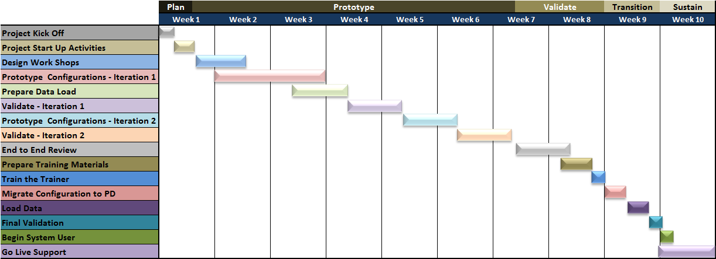
Implementation Timeline

Slide 24
Assumptions and Obligations

Slide 25
Key Assumptions
The standard business flows and Oracle Service Cloud functionality will serve as the base for the implementation.
Oracle’s OUM for Cloud Implementation Approach will be used for the implementation
A small Project team is formed and empowered to make decisions.
A timeline of 10 weeks is assumed with work products delivered during the timeframe, counting from the time that the Service Cloud system is provisioned.
The implementation is based on the Cloud deployment model, hosted at Oracle
In the Cloud deployment model, two project environments are available: A sandbox and a production environment
No Customization is performed. Configuration within the standard system is performed
Single Sign On set-up is not included.
Organizational Change Management will be Client’s responsibility

Slide 26
Typical Deliverables
Deliverables included in scope | Description
Project Charter | The project charter would include further details of the project mission statement, approach and execution.
Project Workplan | A plan that describes the high-level tasks. Resource assignments and timelines for all project activities.
Requirement document | Zensar will provide detailed Business requirements document
Future Business Process Model | Zensar will provide the future process model for the standard configuration of the system.
Configured Application | An application configured in accordance with business process and Future business processes
Test Scripts | Test Scripts for testing the configured functionality in the scope of standard offering
Validated Solution on Sandbox | Configured Final Solution agreed with Customer
Training Material | Detailed instruction documents to perform transactions in Service Cloud
Configuration Workbook | Details of how the solution is configured
Validated Solution on Production | Configured Solution , validated for go live use

Slide 27
Customer Obligations
For the project to be successful Customer must fulfil the following obligations:
Service Cloud environments are available prior to project start
Assign a project manager to lead your staff’s efforts
Assign experienced and empowered business and IT users to work closely with Zensar's consultants according to project plan (some full-time allocation may be necessary at times).
Perform certain project tasks according to project plan such as provide data in format specified, testing, assist data conversions, assist training material preparations, end user training, data validations etc.
Arrange for a project executive sponsor and project steering committee

Slide 28
Why Zensar

Slide 29

Why Zensar!
Dedicated
Cloud Center of RightNow
Oracle Cloud Certified professionals
Fixed Scope Offerings
Proven Cloud Tools, Accelerators and Methodology
Cloud Lab
(Build Proof of concept and DEMOs)
Rich industry and CX package implementation experience
Cloud implementation experience
29

Slide 30








Oracle Cloud Customer Portfolio
Sales Cloud
HCM Cloud Support
Sales Cloud
Fusion Apps Administration
ERP & HCM Cloud
Planning
& Budgeting Cloud
Cloud Financials
Sales Cloud
30

Slide 31
Next Step…
To start your journey towards realizing your CRM vision, please contact us at:
Web: www.zensar.com/
Email: marcom@zensar.com

